Slide 1






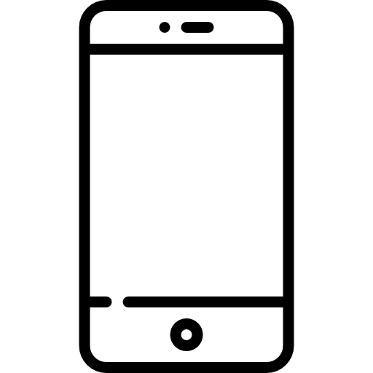


Geolocation API
Notification Message
Fcm Token, Firebase Auth
Geolovation API
Query
Spring Cloud Config
User microservices
RDB
OpenFeign
Eureka Server
Service Discovery
Like microservices
http, ws
Query
NoSQL DBMS
API Gateway
Load Balancing
Match microservices
Message queue
Pub, Sub
Event Broker
Chat microservices

